Slide 1
DM1005 – Digital Marketing Essentials
First Formative Assessment (3 Hours and 10 Mins)
Learner Name: Learner NRIC / FIN No.: [last 3 digits and letter] | Date: June 12, 2026

Slide 2
Important : Read the Instructions Carefully
Each question may need you to write the answers in the slide or take a screenshot and paste in the slide.
Don’t forget to review each answer and/or screenshot before submission.
Question for you to type in the answer.
Question for you to perform a task and screenshot your result and paste it in your Portfolio Slide.

Slide 3
Part I. Multiple Choice Questions (MCQ) Underline the letter of the correct answer 2 Marks each Question

Slide 4
Question 1
Which category of digital marketing includes channels that a business has complete control over, such as its own website or email list?
Owned Media
Paid Media
Organic Media
Earned Medi

Slide 5
Question 2
In the comparison between digital and traditional marketing, which attribute is considered a primary strength of traditional channels like TV and print?
Established trust and credibility
Real-time measurability
Hyper-targeting capabilities
Low fixed entry cost

Slide 6
Question 3
Which digital marketing component is cited as having an exceptionally high average return on investment (ROI) of approximately £42 for every £1 spent?
Pay-per-Click (PPC)
Social Media Marketing (SMM)
E-mail Marketing
Search Engine Optimization (SEO)

Slide 7
Question 4
A business wants to increase its 'Brand Awareness'. Which of the following Key Performance Indicators (KPIs) would be most relevant to this goal?
Cost-Per-Lead (CPL)
Ad Impressions
Customer Lifetime Value
Repeat Purchase Rate

Slide 8
Question 5
According to the channel selection principles, what is the recommended starting point for a business with a limited budget?
Programmatic Ads + SMS Marketing
SEO + Email + Organic Social
Video Marketing + Podcasts
PPC + Display Ads + Influncers

Slide 9
Question 6
When defining a target audience, which dimension involves researching a customer's values, beliefs, and aspirations?
Demographics
Psychographics
Geographics
Behavioral

Slide 10
Question 7
In the customer funnel, at which stage would 'Comparison Guides' and 'Webinars' be most effective for moving a prospect forward?
Awareness
Considerations
Conversions
Advocacy

Slide 11
Question 8
What is the primary disadvantage of using Paid Search (PPC) as a marketing channel?
Visibility Stops when the budget ends
It is difficult to target specific keywords
It takes 3-6 months to see the results
It requires technical knowledge to manage

Slide 12
Question 9
True or False, You can have unlimited Ad Accounts in Facebook Business Portfolio/Business Account
True
False

Slide 13
Question 10
True or False, you can manage your Facebook Page, Users and other assets in your Facebook Business Portfolio/Business Account.
True
False

Slide 14
Part II. Open-Ended Questions Answer the given questions briefly

Slide 15
Learning Unit 1 Fundamentals of Digital Marketing (50 Marks)
Marking Rubrics:
Criteria | Excellent (4–5 marks) | Good (3 marks) | Basic (2 marks) | Limited (0–1 mark)
Understanding of Case | Accurate and complete interpretation | Mostly accurate | Basic understanding | Misinterpreted case
Application of Concepts | Strong, relevant application to case | Some relevant application | Limited application | No clear application
Analysis & Evaluation | Insightful, well-justified arguments | Some analysis present | Minimal reasoning | No critical thinking
Creativity & Problem Solving | Innovative and realistic solutions | Some creativity | Limited ideas | No practical solutions
Clarity & Structure | Well-organized and clear | Generally clear | Somewhat unclear | Disorganized

Slide 16
Question 1 (5 Marks)
Write an example of a SMART objective for a Digital Marketing Campaign
Answer:

Slide 17
Question 2 (5 Marks)
Write two Tactics for the given campaign objective – “ To get 1000 quality leads every month for the next three months”
Answer: 1. 2.

Slide 18
Question 3 (5 Marks)
In your own words, differentiate digital marketing from traditional marketing.
Answer:

Slide 19
Question 4 (5 Marks)
Given the tactic “Search Engine Marketing (SEM)/Pay-Per-Click (PPC)” provide 1 Key Performance Indicator (KPI) and the corresponding tactic.
Answer:

Slide 20
Question 5 (5 Marks)
Provide five (5) examples of social media platforms
Answer: 1. 2. 3. 4. 5.

Slide 21
Question 6 (5 Marks)
Provide one advantage and disadvantage of Email Marketing
(Advantage) Answer: (Disadvantage) Answer:

Slide 22
Question 7 (5 Marks)
Discuss the difference between Search Engine Optimization (SEO) and Search Engine Marketing (SEM)
Answer:

Slide 23
Question 8 (5 Marks)
What does SMART stands for?
Answer: S – M – A – R – T –

Slide 24
Question 9 (5 Marks)
Identify the potential audience settings for a printing company that wants to advertise through its Facebook Page.
Answer: Demographics – Geographics – Psychographics –

Slide 25
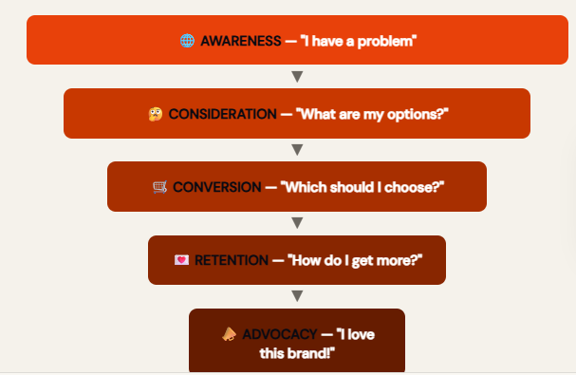
Question 10 (5 Marks)
What do you understand in the given diagram? Explain.
Answer:

Slide 26
Part III. Hands-On/Practical Activity Take a screenshot of the Interface as evidence

Slide 27
Learning Unit 1 Fundamentals of Digital Marketing (30 Marks)
Marking Rubrics:
Criteria | Excellent (4–5 marks) | Good (3 marks) | Basic (2 marks) | Limited (0–1 mark)
Understanding of Case | Accurate and complete interpretation | Mostly accurate | Basic understanding | Misinterpreted case
Application of Concepts | Strong, relevant application to case | Some relevant application | Limited application | No clear application
Analysis & Evaluation | Insightful, well-justified arguments | Some analysis present | Minimal reasoning | No critical thinking
Creativity & Problem Solving | Innovative and realistic solutions | Some creativity | Limited ideas | No practical solutions
Clarity & Structure | Well-organized and clear | Generally clear | Somewhat unclear | Disorganized

Slide 28
Question 1
Screenshot and paste here the Facebook Page you had set up for your business

Slide 29
Question 2
In your Meta Business Suite account, create a new Business Portfolio Account. Screenshot your Business Portfolio Account name and paste here.

Slide 30
Question 3
Screenshot the section of your Facebook account where you can switch from your personal profile to your Facebook Page. Paste the screenshot here

Slide 31
Question 4
In your Facebook Page, create a post with text and images regarding the

